Slide 1
Town Facilities Utilization
Town Council Sub-Committee
Presentation
August 13, 2018
Nick Pouder – Chair
Gary Hida – Vice-Chair
Wendy Faulenbach – Secretary
Stephen Confortini
Chris Cosgrove
Joseph Degregorio
Michael Sennello

Slide 2
Charter
Created at February 26, 2018 Town Council meeting.
Charged with accessing the utilization of all structural assets owned by the town.

Slide 3
Work Performed
Created and reviewed the list of properties to be considered
Surveyed departments on the state of their facilities
Where possible, interviewed staff and gathered other information about the properties
Toured all properties
Compiled all information
Discussed recommendations (Major and other)
Wrote final report to be issued after final edits
Notes:
Where possible gathered other information about the properties (maintenance, utilities, head count, prior studies)

Slide 4
Properties
28 distinct properties
48 individual buildings
$17,800,000 assessed building value
$15,600,000 assessed land value
252,500 square feet of space
85 acres not counting Sullivan Farm or shooting range
8 buildings date from the 1800s
Since 1989 only 2 buildings have been built
Notes:
Even with counting DPW Young’s Field Road as one asset
1800’s Railroad Station, Northville School, Town Hall, Library, Gaylord’s School
1989 Police, 2010 Ambulance, 2017 Lynn Demming

Slide 5
Properties
Pump Station #4
20 Church St Red Barn 1
20 Church Street Red Barn 2
25 Church St east barn
25 Church St west barn
25 Church St. main building
Ambulance Headquarters
Animal Control
Bridge St. - former post office bldg
Clatter Valley PD Shooting Range
DPW 1
DPW 2
DPW 3
DPW 4
DPW 5
DPW Braden Building
DPW Truck wash building
DPW Salt Barn
Catherine Lillis Building
Facilities Maintenance Bldg
Gaylordsville School House
Geiger Radio Building
Lanesville Fire Station
Library
Lynn Deming Barn at Road
Lynn Deming beachfront shed
Lynn Deming Guard House
Lynn Deming Lifeguard Shack
Lynn Deming Workshop/Garage
Lynn Deming Open Pavilion
Lynn Deming Restrooms
Northville School House
Parks and Rec. Condo
Pettibone
Police Dept.
Railroad Station
Recycling center fabric canopy
Recycling Center office
Recycling Center plastic shed
Recycling center wooden shed
Richmond Center
Sullivan Farm Brown Barn
Sullivan Farm High Tunnel
Sullivan Farm Main Barn
Sullivan Farm Pole Barn/ garage
Sullivan Farm Sugarhouse
The Maxx
Town Hall

Slide 6
Department Survey Summary
Scale of 1 – 5 (including NA)
A response of “3” is considered “acceptable”
Overall least satisfied with HVAC
Overall most satisfied with IT
Town Hall HVAC appears to be an issue for many.

Slide 7
Key Findings
Approximately 45,600 sf (18% of total) is vacant:
Pump Station #4 -- 6,000 sf
Pettibone – 25,000 sf (54% of total) plus kitchen, library, cafeteria, gymnasium
25 Church Street – 2,000 out of 4,000 sf total, plus downstairs lightly used
Bridge Street – 1,300 sf lower level
Town Hall – 1,000 sf former court offices and lower level space
Richmond Center – 5,300 sf top floor
East Street – 5,000 sf plus gymnasium
The Police Department female locker room is inadequate for staff.
Some offices in Town Hall are crowded
DPW operations are hampered at its current location and renovations at that site are challenging, at best.
Notes:
This is unused space and does not include that which is occupied at these locations.

Slide 8
Major Recommendations
General
Change the town financial system so utility costs can be evaluated by department and/or building.
All sub-committees examining town assets should collaborate and share information. (Rec Fields, Community Center, Library, Riverfront Revitalization)
Create a centralized scheduling platform for shared spaces (gyms, meeting rooms, kitchens etc) across all town entities including BoE, Library, Youth Agency, Parks & Rec, and Mayor’s office
Notes:
There is no way to assess the utility use by building or department.
This committee exchanged information with the Community Center group but there is no mechanism to make this happen.
There was no way for the committee to assess the use of meeting space.

Slide 9
Major Recommendations
General
Develop a centralized approach to managing and archiving records across all departments. Records and archive storage use significant space in multiple offices.
Consider consolidating maintenance areas and workshops to reduce duplicative facilities.
Consider the library’s expansion plans when deciding if any additional meeting space is necessary elsewhere.
Develop a long-term strategic plan outlining the use and direction of town facilities. Avoid spur of the moment, piecemeal planning.
Continue to seek out synergies between DPW and Parks and Rec. for shared use of facilities and equipment.
Notes:
These are in order of impact.
5 or 6 or 7 maintenance shops

Slide 10
Major Recommendations
Facility Specific
Consider reuse of vacant space at the historic East Street School. Address cupola and roof issues as soon as possible.
Determine what should be done with the extensive amount of vacant space at JPS. This building, by far, has the most unused space.
Consider retaining the 25 Church Street property due to its strategic downtown location but find a good use for it. Uses could be as an annex to town hall, parking or a tie-in to the library project.
Connect Sullivan Farm to the public water supply. The existing situation costs money and wastes time.
The Parks and Rec storage condominium could likely be consolidated into other facilities.
Reallocate the Town Hall office space formerly occupied by the Probate Court; Renovate small, vacant, lower-level rooms.
Notes:
East Street school report done recently detailed the scope and costs of various possible projects.
25 Church Street is not great space as it is even for meetings. HVAC not working during recent hot weather for meetings. Uneven floor. Not handicap accessible.

Slide 11
Major Recommendations
Facility Specific (continued)
Consider modernizing the storage area for paints and cleaning supplies at Church Street Barn #2.
Evaluate the feasibility of relocating DPW during the riverfront master planning and POCD processes.
Rehabilitate the town’s iconic symbol, the village green bandstand. It needs repair and the lighting is very poor.
Notes:
Depending on the materials and quantity, this could violate an OSHA rule. At the least it seems like a bad idea. (I put this in as a note as it is a real possibility but not 100%)
Bandstand – Sound system?

Slide 12
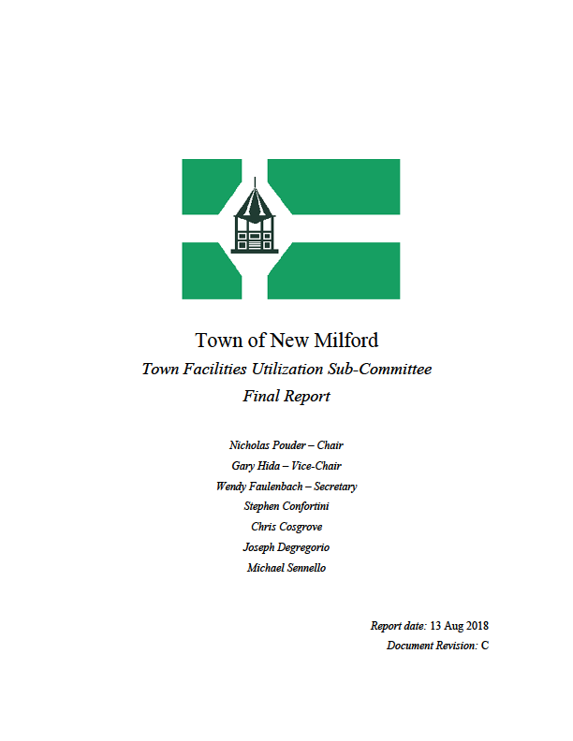
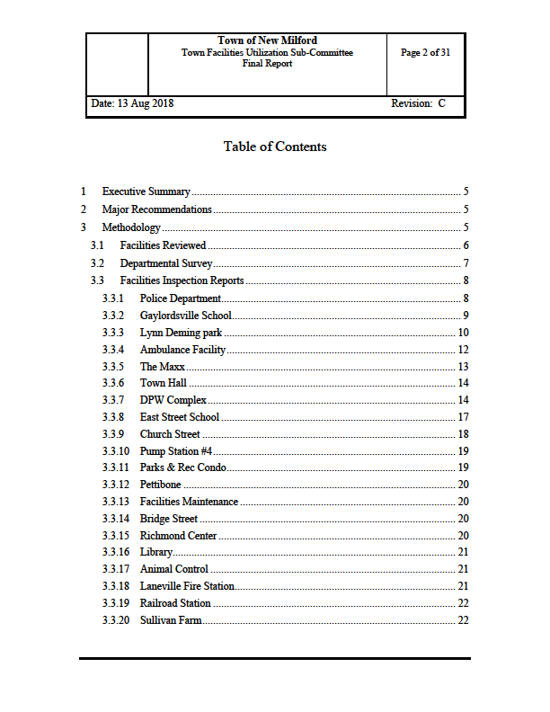
Final Report
Notes:
Where possible gathered other information about the properties (maintenance, utilities, head count, prior studies)

Slide 13
Committee Comments on Future
The village center is one of our biggest assets. We should grow utilization in this area. Government services in the downtown add to the vitality of this area.
Any movements should consider synergies between departments while driving for more space and operational efficiency and improving the public’s interaction with the town.
Time has allowed the town to spread into additional spaces without taking proper inventory (records, junk, clutter) and being efficient in space usage. Clean up.
Notes:
Movements should also consider where uses could create conflict

Slide 14
Town Facilities Utilization
Questions?

