Slide 1
Interim Findings Report
Community Center Committee
September 10, 2018
History Precedent Utilization
Outreach & Feedback

Slide 2
Overview – Community Center Committee
The Community Center Committee (CCC) has met since March 15, 2018, and renewed for another six months on July 24, 2018
This overview includes the CCC’s process, findings, and request for funding an outside firm to conduct further in-depth study
Mayor Bass indicated support for such a study at the June 21, CCC meeting, & Town Council members expressed interest at July 9, TC meeting
The full proposal is included for your review

Slide 3
Six Week Timeline – Proposed Vendor Study
CCC Renewal Through January 24, 2019

Slide 4
Charge
Community Center Committee (CCC) Charge:
Study the feasibility of a NM Community Center
Recommend the CC’s composition, operational structure and finances
Recommend any steps needed to legally accomplish the creation of a CC

Slide 5
Focus
The CCC studied four areas:
History of New Milford’s CCs
Precedent of Similar CT Towns:
CC; No CC; Composition; Facility Type
New Milford’s CC Utilization:
Current and Future Space Needs of Town agencies and potential users
Outreach & Feedback:
Collection & Analysis of Citizen Input Regarding Desire for a CC & Potential Elements

Slide 6
History
Four CCs have existed in New Milford:
Three run by the Town; One Privately managed
Town: 29 Church Street (Old Telephone Exchange); Senior Center; John Pettibone Community Center (JPCC)
Private: Merryall Community Center
Three of the four currently exist
Based upon the CCC’s research, New Milford is the only Town in CT to close or discontinue a CC

Slide 7
History
Most Complete CC existed in the 1960’s and early 1970’s
Located at 29 Church Street
Parks and Rec was first Town Agency to occupy
Programs offered to all ages and provided various experiences
Youth programs included sports, arts & crafts, a popular after school program including a game room
Adults had classes for personal and professional development

Slide 8
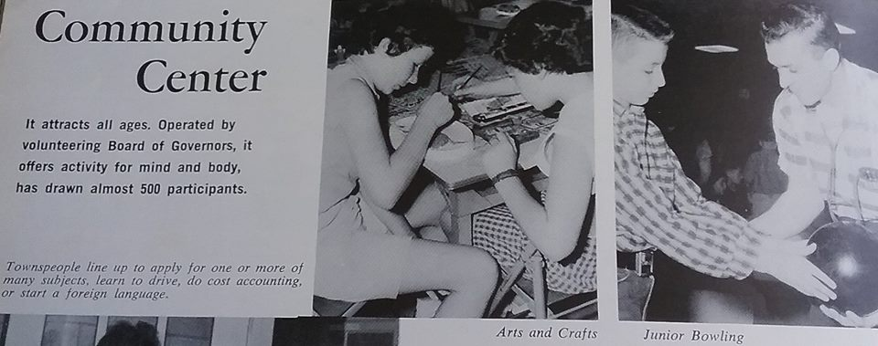
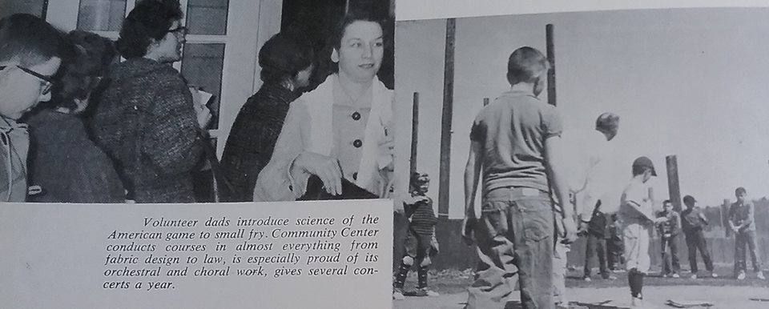

Slide 9
History
Why did the Community Center cease to exist?
A Lack of Will on the part of the Town, public entities, and volunteer leadership
Town agencies moved into 29 Church St
Zoning, Health Department, and others
Parks & Rec lost a lot of space due to these moves & could no longer support most of the CC programs
The Teen Center remained open for a short while, but eventually closed due to space constraints
That was the end of the CC in New Milford

Slide 10
History
The Senior Center serves it’s clients very well
In some Towns, the Senior Center is the only CC, or part of a multi-agency facility
The Merryall CC was founded in 1951
Focus is on performing artists, readings, speakers, and education
Run by a Board of Directors
Unique example how a specialized center can serve its community

Slide 11
Precedent
How do similar Towns compare to New Milford?
CCC used two groups of Towns for comparison
The 8 Towns that abut New Milford
22 Towns in Educational Reference Group D, developed by the State of CT, which New Milford is part of
It compares Towns with similar demographic characteristics
Analysis included a 20 item questionnaire and reviewing the various Town’s websites

Slide 12
Precedent
Multiple Definitions of “Community Center”
Multiple ways to organize how services are provided
Size varies from 800 s.f. to 50,000 s.f.
20 Towns do not have a dedicated CC
6 Towns focus primarily on outdoor athletic facilities
At least 3 Towns have CC combined with, or located in, other municipal buildings
4 Towns have the Senior Center as the only CC

Slide 13
Precedent
10 Towns have centralized, dedicated CC facility
Some notable Town investments
Wallingford: Renovated office building; 50,000 s.f.; Agencies & Recreation; $2.3 million cost
Branford: Renovating 33,000 s.f. mixed use facility; $12.5 million cost
Newington: Voters approved $28.5 million to replace Town Hall and include CC, Town Offices, Board of Ed; Voter support nearly 2:1 in favor

Slide 14
Precedent
2 Towns with Swimming Pools
Shelton & North Haven have indoor pools
None of the facilities have an outdoor pool
Not-For-Profit CC Examples
Brookfield: YMCA
Sherman: JCC
Stonington: Beach, sports facilities, playground

Slide 15
Precedent
Goal of Study and Moving Forward
Goal: Estimate size and costs for New Milford based upon similar facilities in similar Towns
Size and Cost for New Milford cannot be accurately projected until a number of factors are determined: programs; departments; design or renovation

Slide 16
Utilization
The task of the Utilization Sub-Committee
To look at current space and future need requirements for Town Agencies
Potential new users/tenants of a CC
Potential revenues from non-profit tenants

Slide 17
Utilization
At the JPCC, the following Town Departments are Tenants:
Parks and Rec
5,043 sq. ft. + 2,025 sq. ft. in 3 temporary rooms
Gymnasium/Stage – 4,941 sf occupant load 706
Social Services
4768 s.f., which includes Town Food Shelf

Slide 18
Utilization
JPCC Tenants, cont.
Youth Agency
9,282 sq. ft. in JPCC plus 8,000 sq. ft. at Maxx, and approx. 2,000 sf shop and storage at East Street.
Maxx: 8000 s.f.
CERT: 750 s.f.
Cafeteria – shared 2640 s.f.
Total Space: 37499 s.f.
29449 s.f. in JPCC; 8000 in Maxx

Slide 19
Utilization
Future Use and Utilization
Current Agencies satisfied with their space at JPCC
Potential New Users/Tenants
Robotics & Beyond
Culinary School
Northville Amateur Radio Association
Literacy Volunteers
Thrift Mart
Other local groups (Boy and Girl Scouts, etc.)

Slide 20
Utilization
Potential Revenue from New Users/Tenants
Hosting only Town Agencies does not generate rent revenue.
Most groups who have expressed interest in being housed in a CC have said they would pay rent.
Key Potential Tenants include Culinary School & Thrift Mart
They contribute a great deal to New Milford through job training & scholarships to NMHS Seniors

Slide 21
Utilization
Findings: Potential New Users/Tenants
Culinary School: Wants JPCC kitchen space & shared access to cafeteria
Currently paying $1500/month
Thrift Mart: Wants 5 rooms (3,750 s.f.)
Willing to pay market rate.
They donate approx. $100,000 to town entities
Robotics & Beyond: Wants 1-2 classrooms with additional space for summer camp
Can pay roughly $1000/month
Total potential space needs: 7,200 – 8700 s.f.

Slide 22
Outreach
Conducted a month long survey of New Milford residents
Distributed online through email lists from:
New Milford Public Library, Board of Ed, Social Services, Parks and Rec, Youth Agency, and Senior Center
Received 1466 Responses online; 83 paper responses

Slide 23
Outreach
Key Finding:
A majority of respondents, roughly 80%, expressed a desire for a Community Center in New Milford
This data is nearly the same as the 72% desire for a Community Center recorded in the 2010 POCD
This adds validity to both the 2010 and 2018 surveys

Slide 25
Outreach
Respondents suggested a mix of services, including:
Government agencies, Recreation, and Educational Opportunities
These should be for residents of all ages

Slide 26
Next Steps
CCC requests $18,500 for a professional firm to conduct workshops and a in-depth survey
Our research and multiple company proposals has lead us to choose Great Blue for this work
As the CCC continues to seek community input, we will also take a serious look at options for a community center
New vs. Existing, mix of services, locations, various costs and upgrades

Slide 27
Thank You!
QUESTIONS?

