Slide 1

2026-2027 Police Budget Presentation- Recent Statistics

Slide 2
2026-2027 Police Budget Recent Traffic Enforcement Focus
Budget Avoidance – Traffic Enforcement Grants Total
FY2024-2025 FY2025-2026
Motor Vehicle Grant Awards $117,171 $155,088
( Speed and Aggressive Driving, DUI, Distracted Driving, Click It or Ticket, Rural Speed Enforcement)
Traffic Enforcement 2024 2025
Motor Vehicle Stops 3,463 4,687
MV Accidents 954 918
Infractions 1,243($309,071) 1,881($410,118)
Written Warnings 1,033 1,496
DUI Arrests 95 114
Misdemeanors 386 307

Slide 3
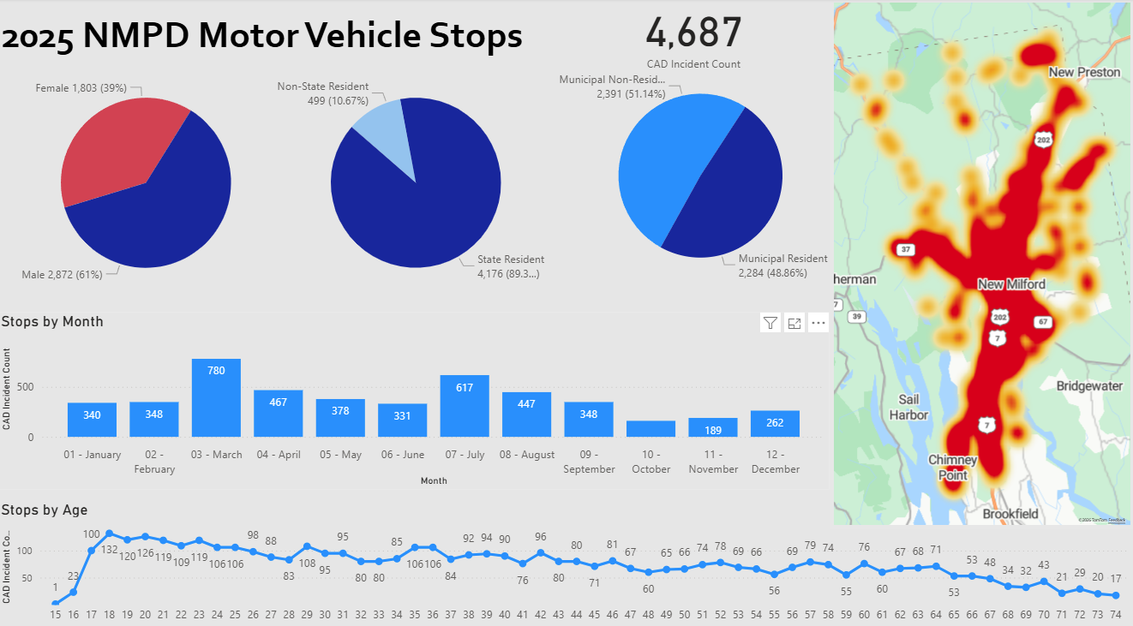
2026-2027 Police Budget

Slide 4
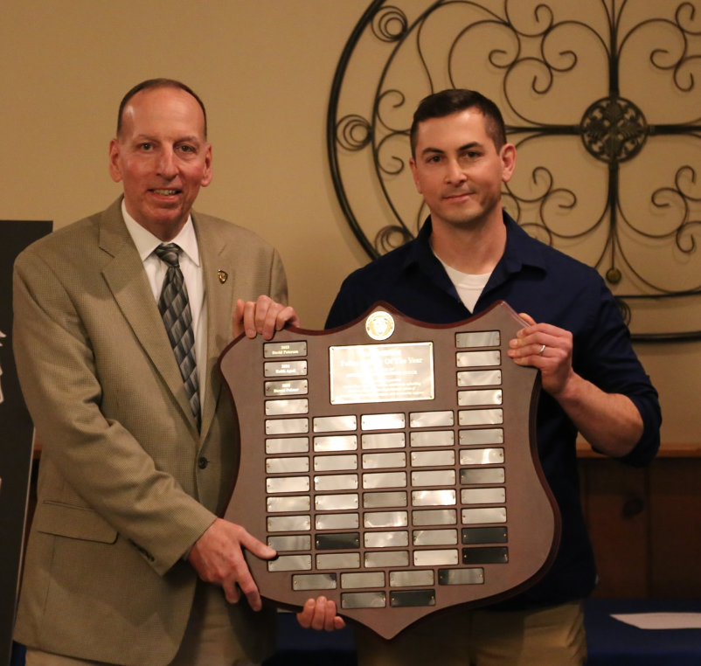
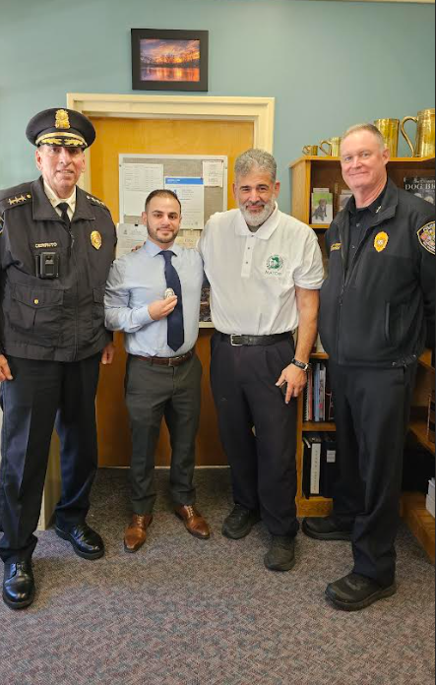
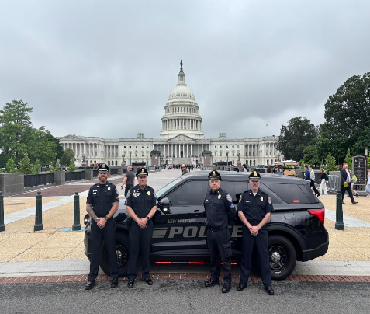
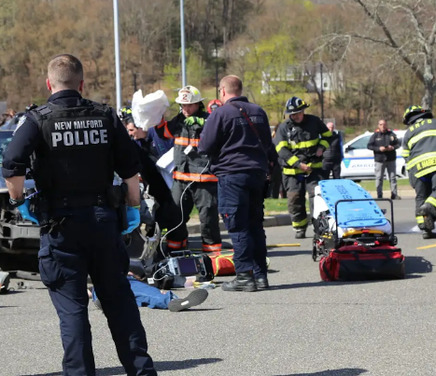
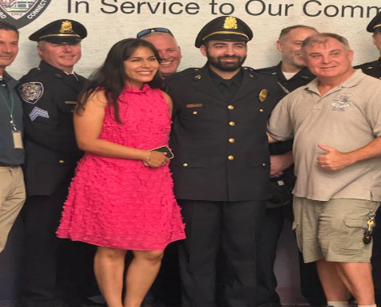
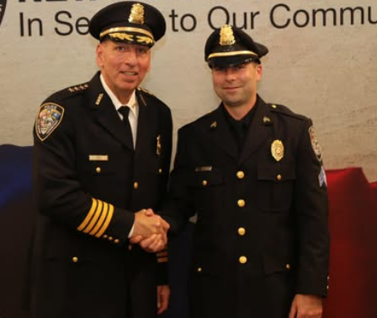
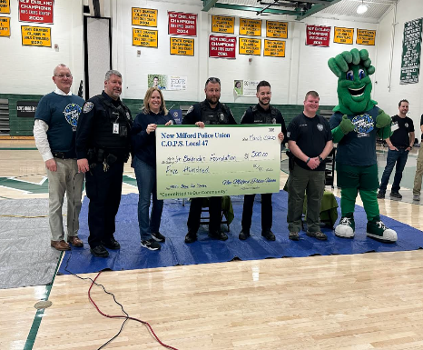
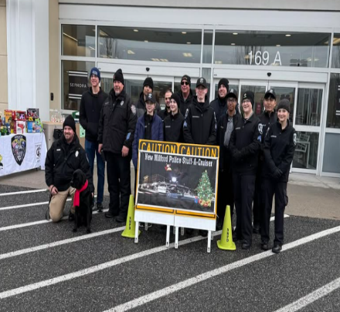
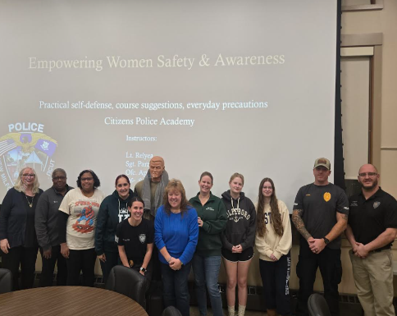
2026-2027 Police Budget Highlights of a Great Year!
Notes:
Third LT and New Hire, Cadet Program, MC Unit (Dream Ride, Escorts, Traffic Enforcement) and Officer of the Year, New Traffic Cruiser, Additional K9, Tier 1 Accredidation

Slide 5


2026-2027 Police Budget Strategic Accomplishments
Parole/Probation/Sex Offender Checks
Vape Shop Compliance Checks
Assigned Detective to Narcotics Taskforce
Drug Overdoses Down
Working on Tier 2 and Tier 3 Accreditation
Qualified for Traffic Enforcement Grants ($155,088)
DUI Checkpoint
Standardized Roll Call Training
Polish National Police
Officer of the Year Award
Improvement in Fleet
Promoted Two New Sergeant’s
Video Text to 911/ Viper
Ranked 5th Safest Town in CT
Increased Security at Large-Scale Events to Ensure Public Safety and Effective Crowd Management
New Custom Badges
Active Shooter Training
Continuous De-escalation Training
Expansion of the Crisis Intervention Team
Community Outreach- 577 Welfare Checks
Completed 6th Citizen’s Police Academy
New Female SSO in High School
3 Detectives with the Federal Internet Crimes Against Children’s Taskforce
Purchased Intel Software

Slide 6
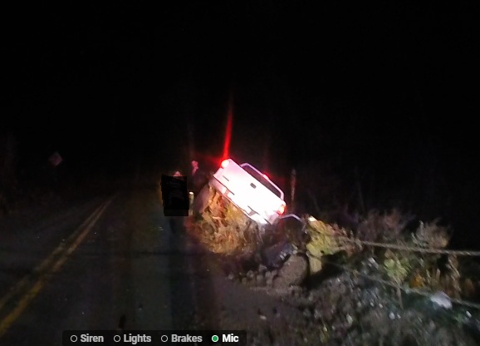
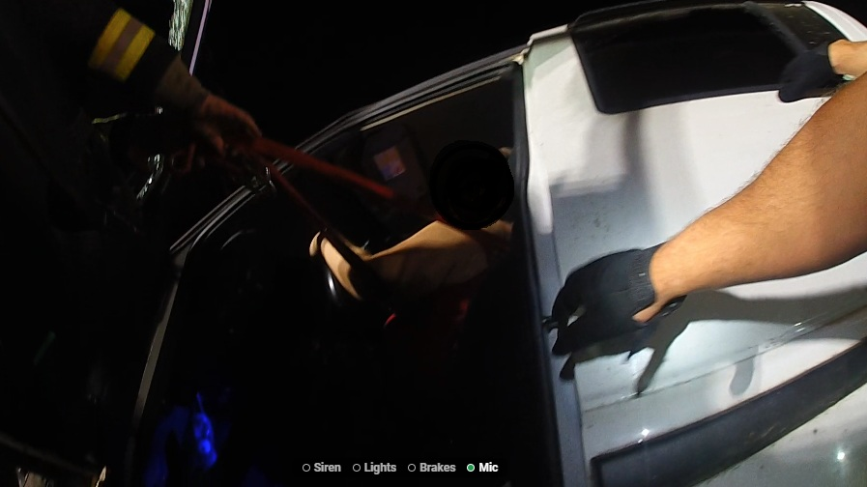
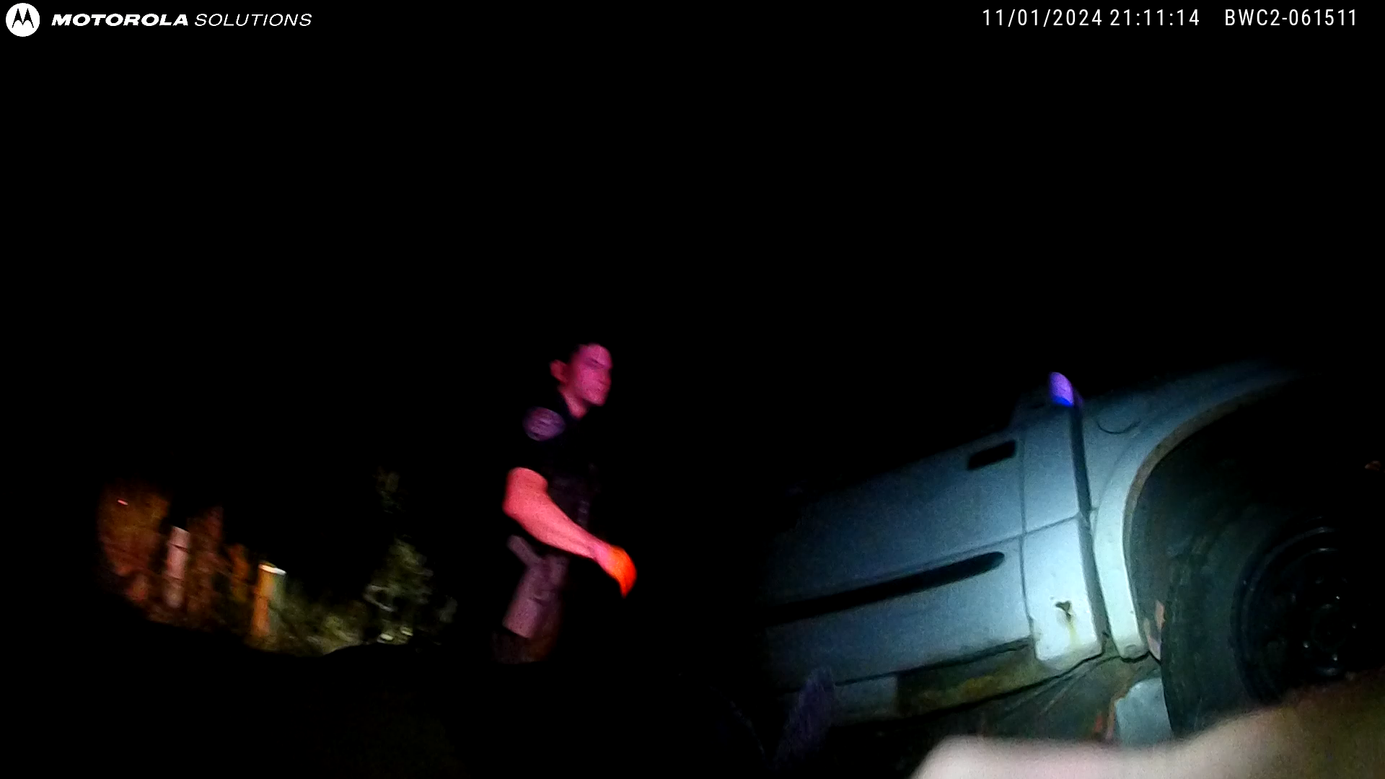
2026- 2026-2027 Police Budget

